Slide 1
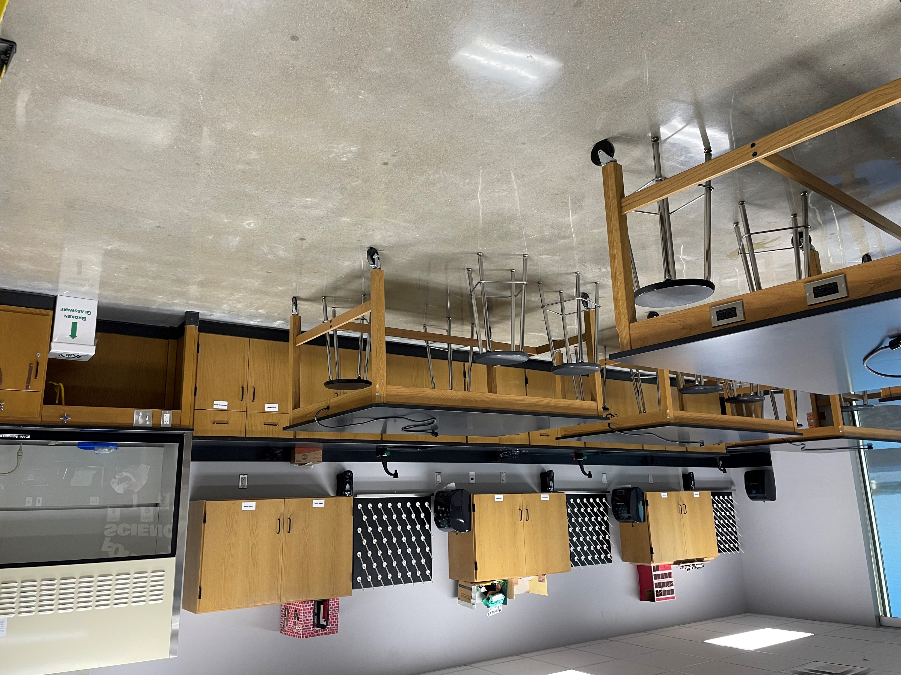
Law Enforcement
Statewide Program of Study
Law and Public Service Career Cluster
The Law and Public Service Career Cluster focuses on planning, managing, and providing legal services, public safety, protective services, and homeland security, including professional and technical support services. Students will examine the roles and responsibilities of police, courts, corrections, private security, and fire and emergency services.
The Law Enforcement program of study teaches CTE learners about the development of, adherence to, and protection of various branches of law. Students will learn how to appropriately and legally respond to breaches in the law according to statutory rules and regulations as well as investigate how and why the breaches occurred.
Secondary Courses for High School Credit
1 Principles of Law, Public Safety, Corrections, and Security
2 Law Enforcement I
3 Law Enforcement II
4 Practicum in Law, Public Safety Corrections, and Security
OR
Forensic Science
Work-Based Learning and
Expanded Learning Opportunities
Exploration Activities | Work-Based Learning Activities
Join the Texas Public Service Association or local criminal justice clubs | Attend court hearings and other legal procedures
Industry-Based Certifications
Non-Commissioned Security Officer Level II
Postsecondary Opportunities
Associates Degrees
Criminal Justice/Safety Studies/Law
Enforcement Administration
Criminal Justice/Police Science
Corrections
Criminalistics and Criminal Science
Bachelor’s Degrees
Criminal Justice/Safety Studies/Law
Enforcement Administration
Criminal Justice/Police Science
Juvenile Corrections
Cyber/Computer Forensics and Counterterrorism
Master’s, Doctoral, and Professional Degrees
Criminal Justice/Safety Studies/Law
Enforcement Administration
Natural Resources
Law Enforcement and Protective Services
SMHS Forensics Lab
Aligned Occupations
Occupations | Median Wage | Annual Openings | % Growth
Police and Sheriff's Patrol Officers | $60,112 | 5,241 | 13%
Probation Officers and Correctional Treatment Officers | $44,054 | 793 | 9%
Correctional Officers and Jailers | $40,186 | 4,683 | 9%
Immigration and Customs Inspectors | $78,104 | 1,236 | 9%
First-Line Supervisors of Police and Detectives | $91,312 | 253 | 25%
Successful completion of the Law and Public Service program of study will fulfill requirements of the Public Service endorsement. Revised – August 2022

Slide 2
Law Enforcement Course Information
COURSE NAME | SERVICE ID | PREREQUISITES | COREQUISITES
Principles of Law, Public Safety, Corrections, and Security | 13029200 (1 credit) 6600 | None | None
Law Enforcement I | 13029300 (1 credit) 6610 | Principles of LPsCS | None
Law Enforcement II | 13029400 (1 credit) 6615 | Law Enforcement I | None
Practicum in Law, Public Safety, Corrections, and Security | 13030100 (2 credits) 6620 | Law Enforcement II | None
Forensic Science | 13029500 (1 credit) 6611 | Biology and Chemistry | None
FOR ADDITIONAL INFORMATION ON THE LAW AND PUBLIC SERVICE CAREER CLUSTER,
PLEASE CONTACT: CJ Odam, SMCISD CTE Coordinator cj.odam@smcisd.net
San Marcos CISD does not discriminate on the basis of race, color, national origin, sex, disability or age in its programs or activities and provides equal access to the Boy Scouts and other designated youth groups. The following person has been designated to handle inquiries regarding the nondiscrimination policies: Stephanie Munoz ; 631 Mill St, San Marcos, TX 78666 ; 512-393-6700 ; stephanie.munoz@smcisd.net
Further nondiscrimination information can be found at smcisd.net/cte

